Slide 1
The evolution of Microsoft Information Protection
from Information Rights Management to Sensitivity Labelling
Peter Rising

Slide 2

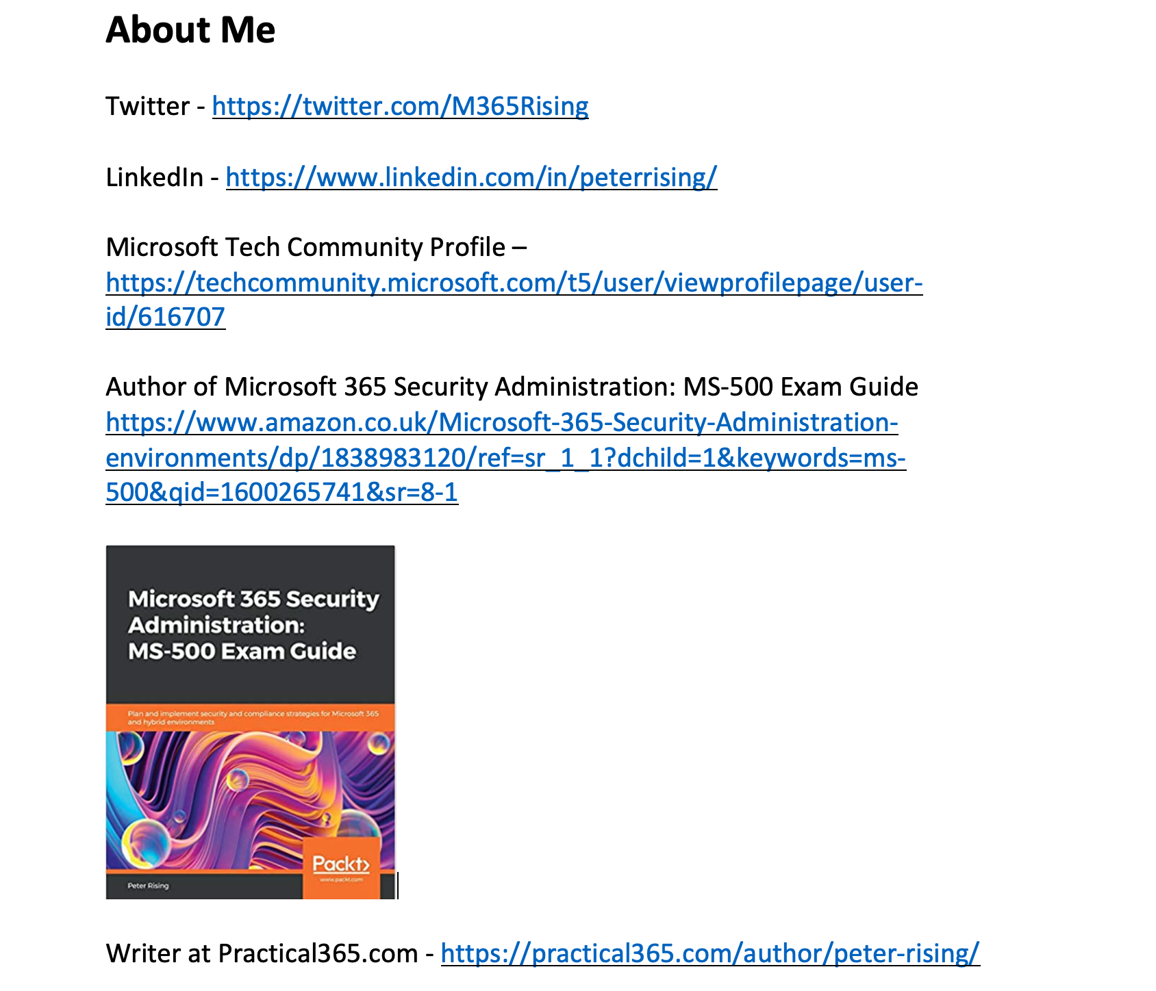
About me

Slide 3
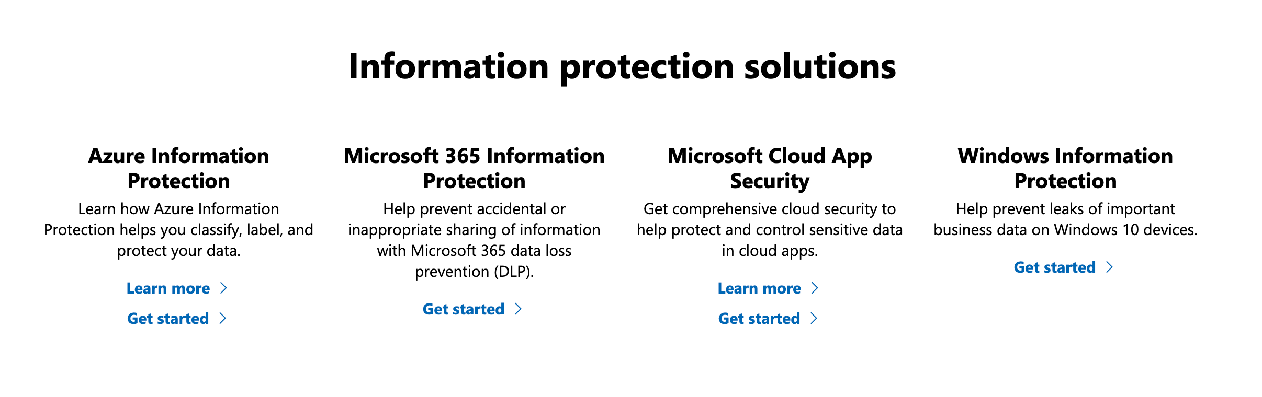
What is Microsoft Information Protection?

Slide 4
A brief history of Information Protection
Rights Management
Azure Information Protection
Sensitivity Labels & Unified labelling
Cloud App Security
Windows Information Protection

Slide 5
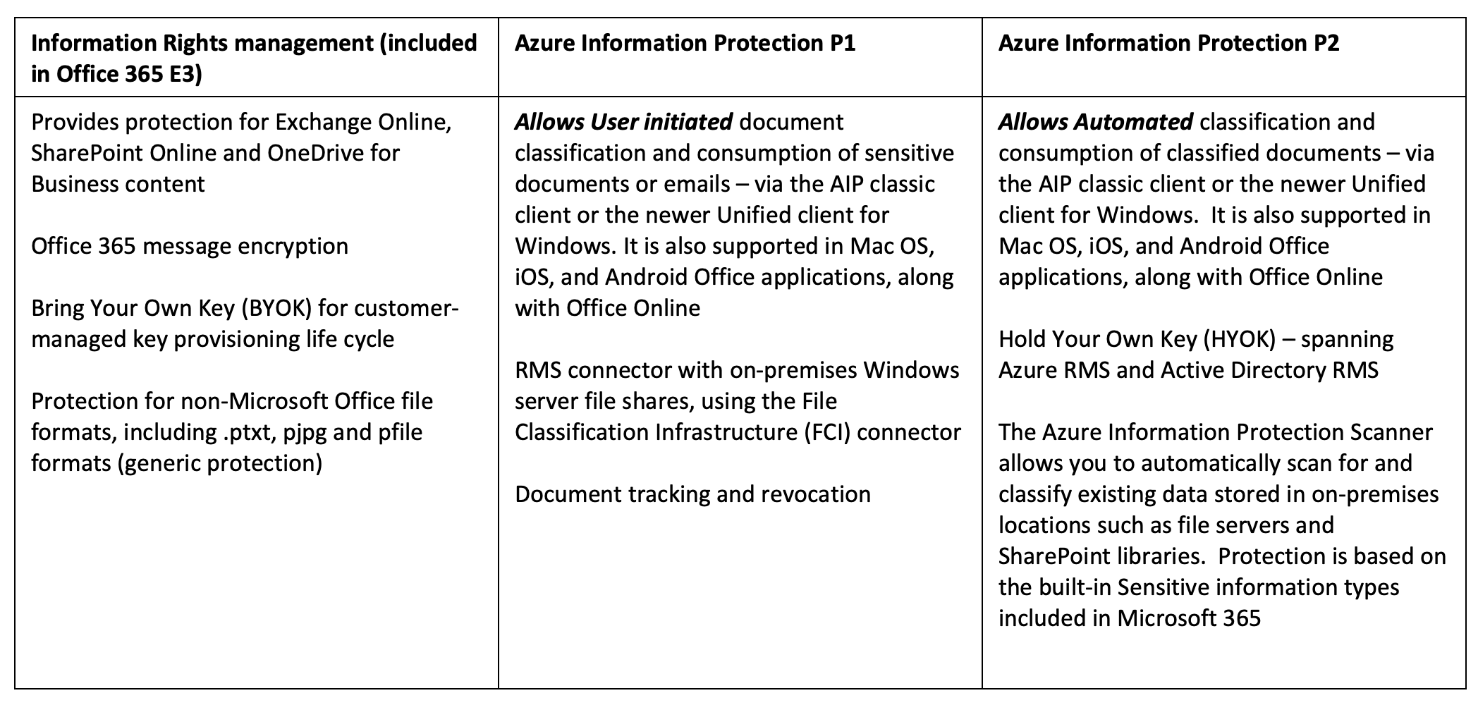
Azure Information Protection

Slide 6
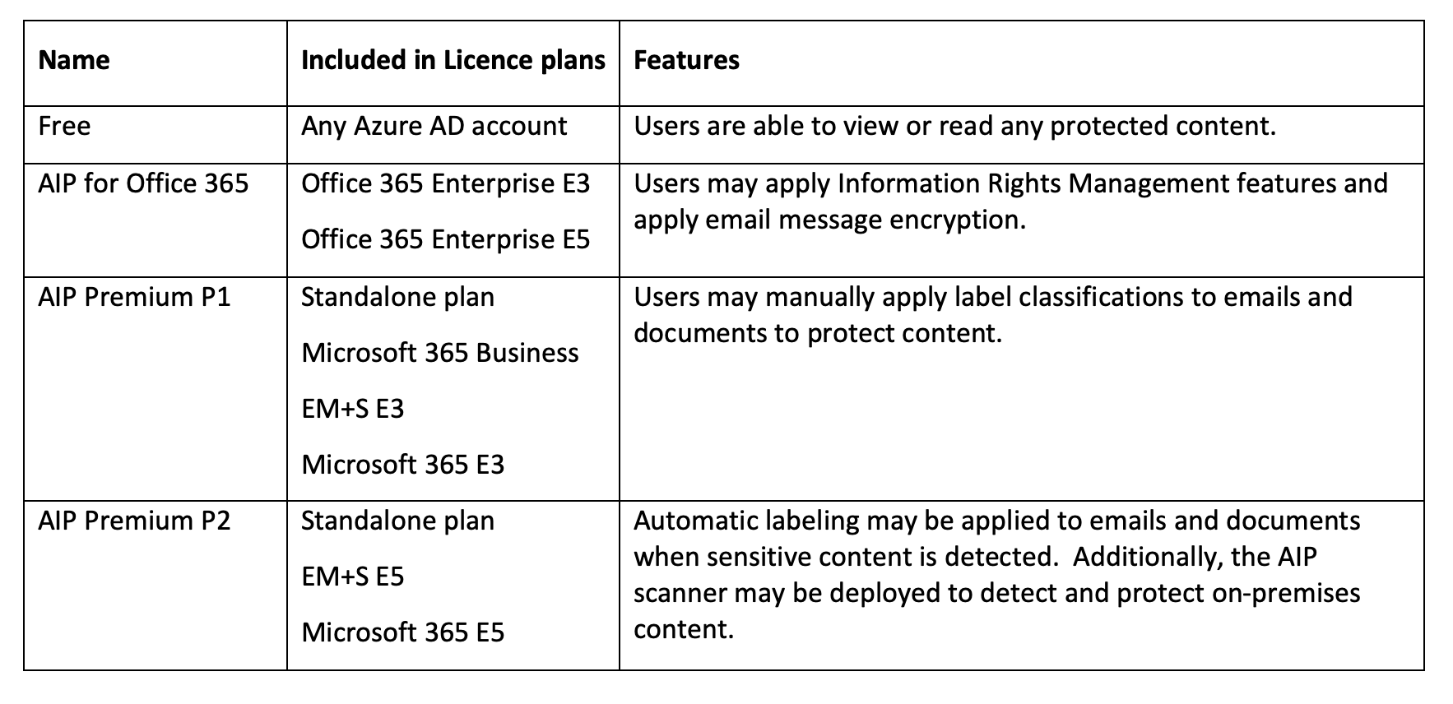
How is AIP licenced?

Slide 7
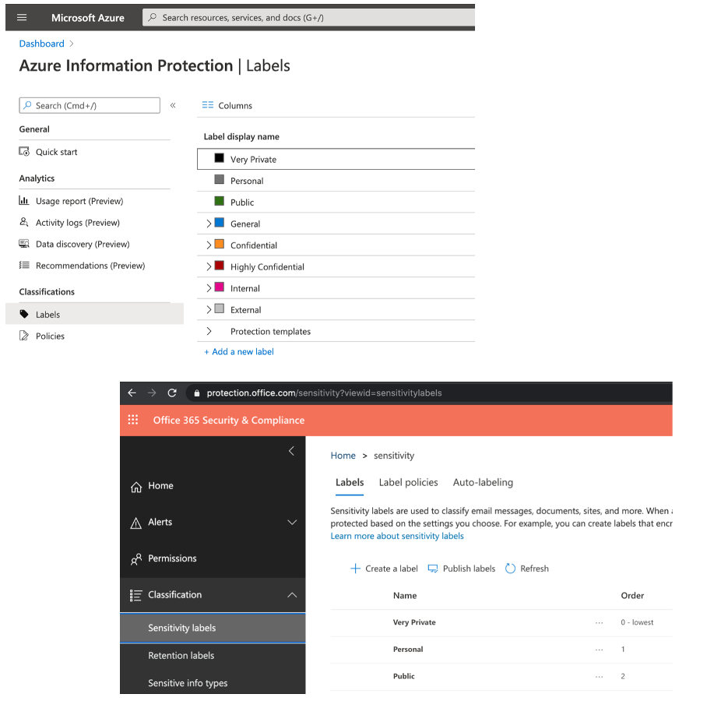
Sensitivity Labels and Label policies
https://protection.office.com
https://portal.azure.com
https://compliance.microsoft.com

Slide 8
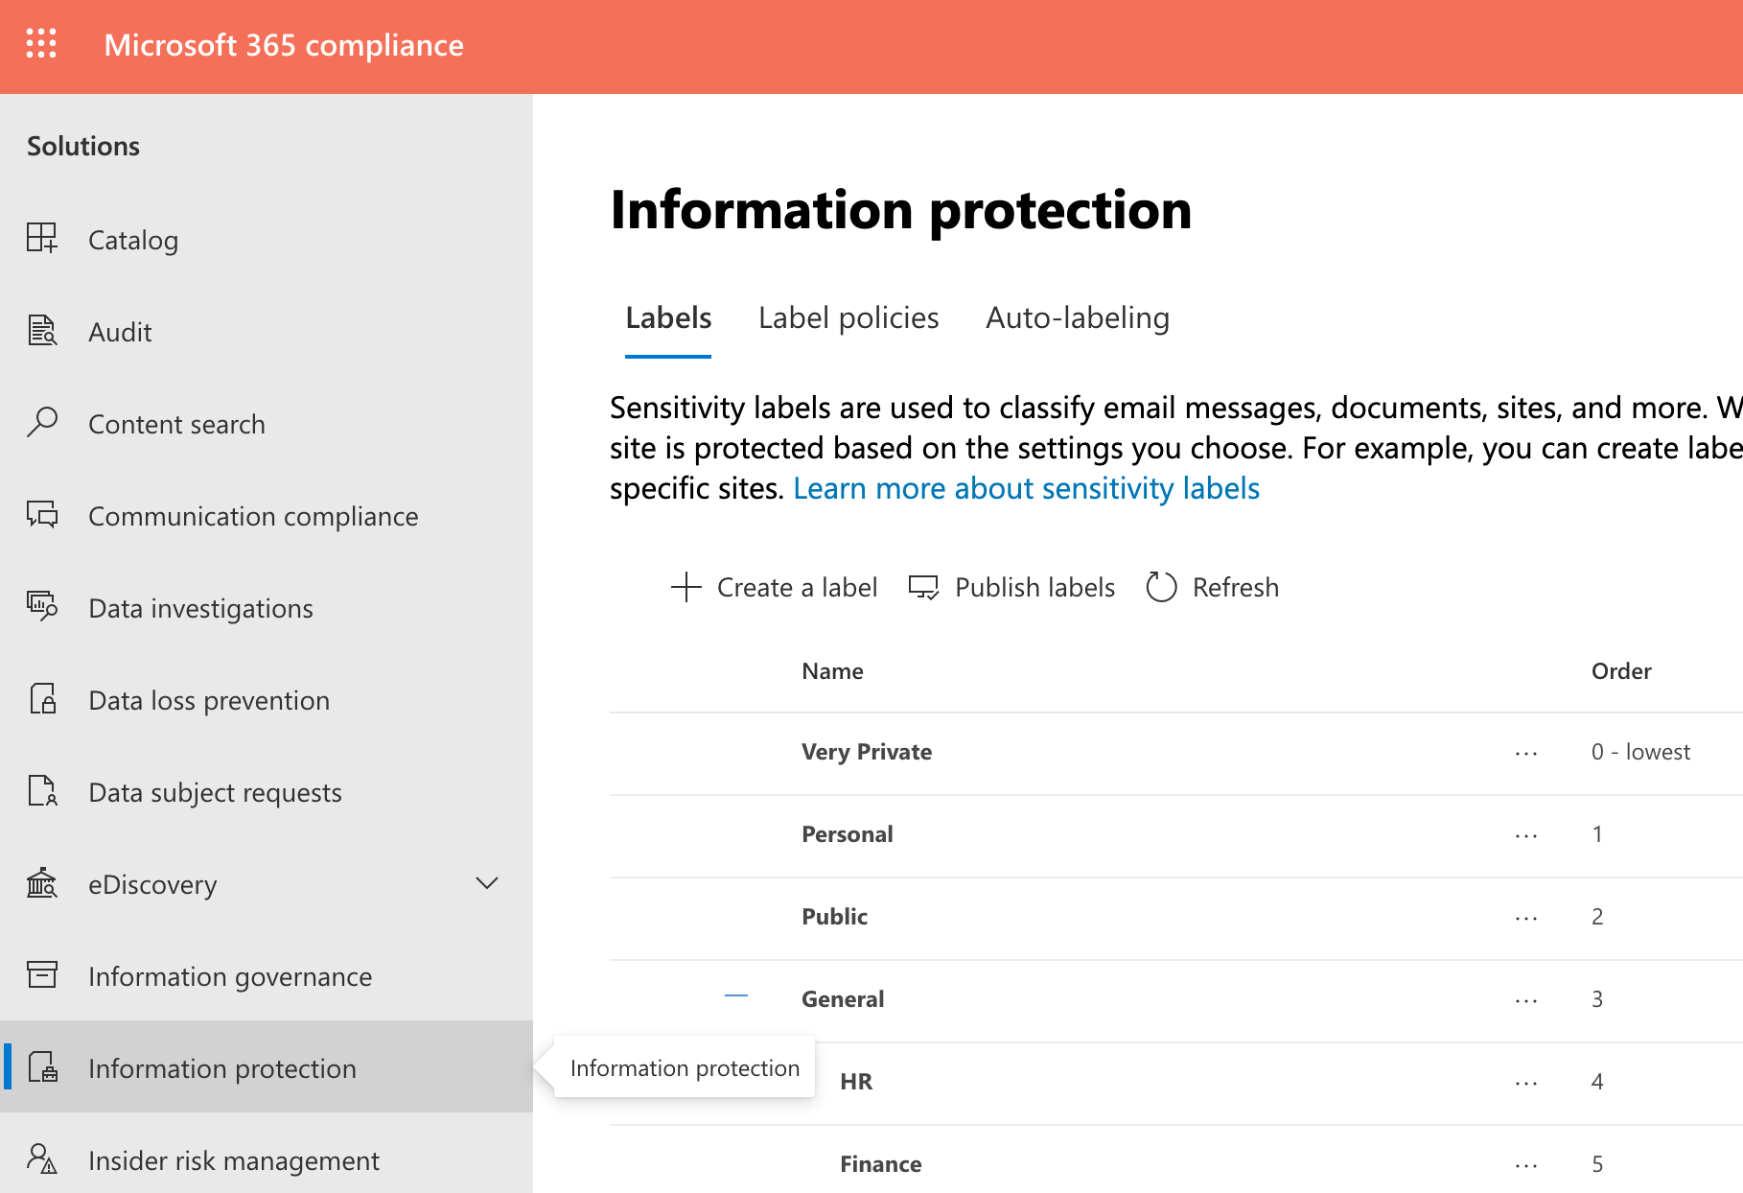
Sensitivity Labels and Label policies
https://protection.office.com
https://portal.azure.com
https://compliance.microsoft.com

Slide 9
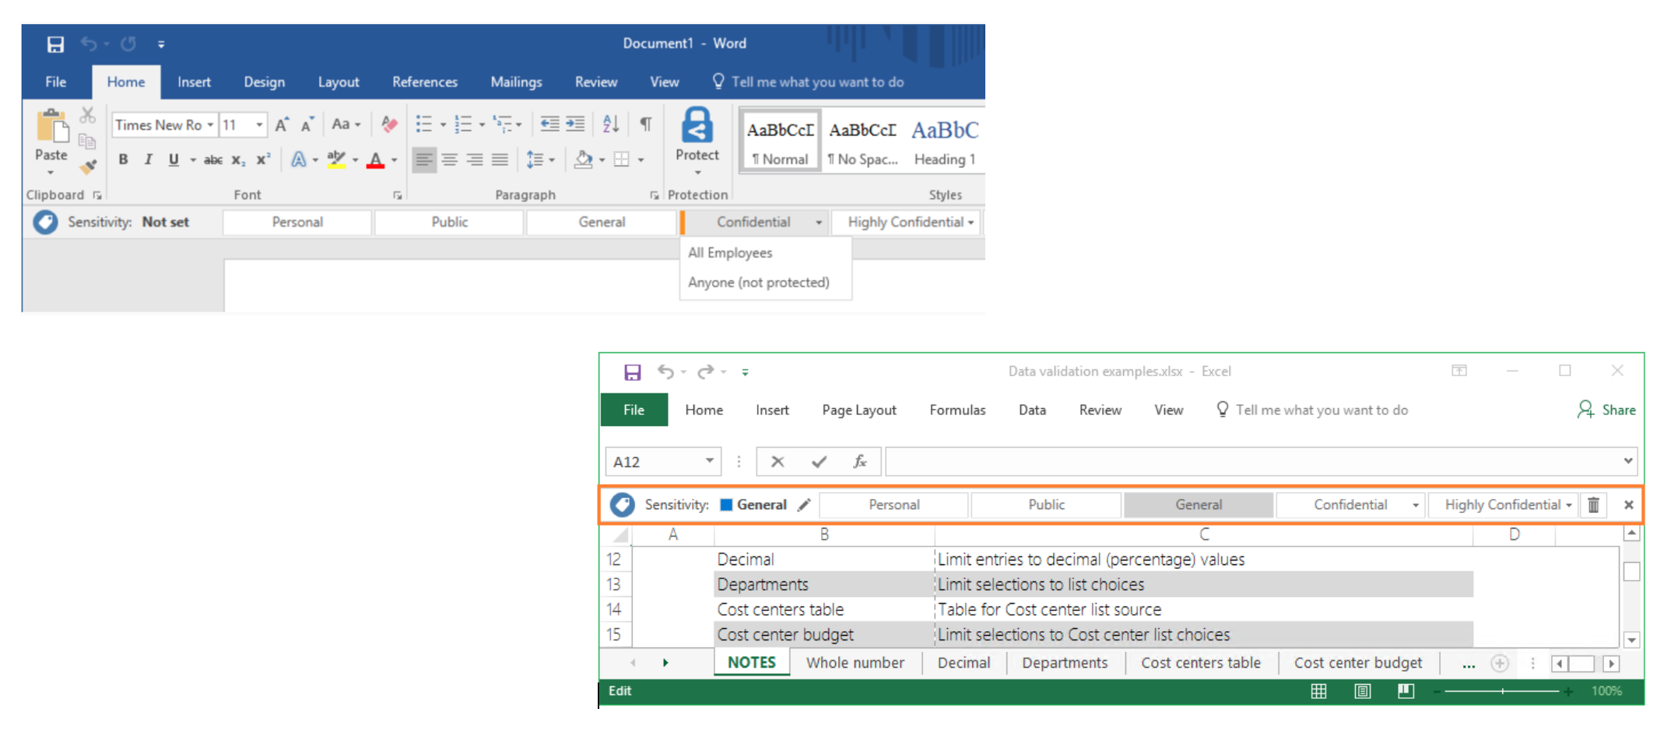
User Experience

Slide 10
Best practices for labelling
Diligently test your Sensitivity labels and policies by deploying to a pilot group
Keep the number of labels to a minimum where possible
Make sure that your labels and descriptions are easy to understand and do what they say
Provide your users with training before deploying labels and label policies to them
Only force automatic classification where necessary
Use built in sensitive information types where possible
Use Office 2016 and keep it updated
Ensure that users are signed into Office 2016 with their Office 365 account
Use Sensitivity labels and policies in conjunction with DLP to maximise data protection and prevent against accidental sharing of sensitive data

Slide 11
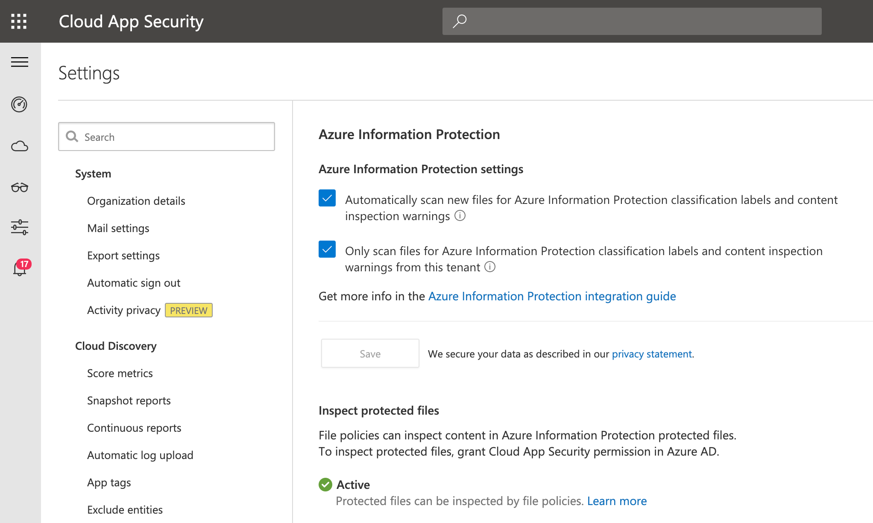
Cloud App Security

Slide 12
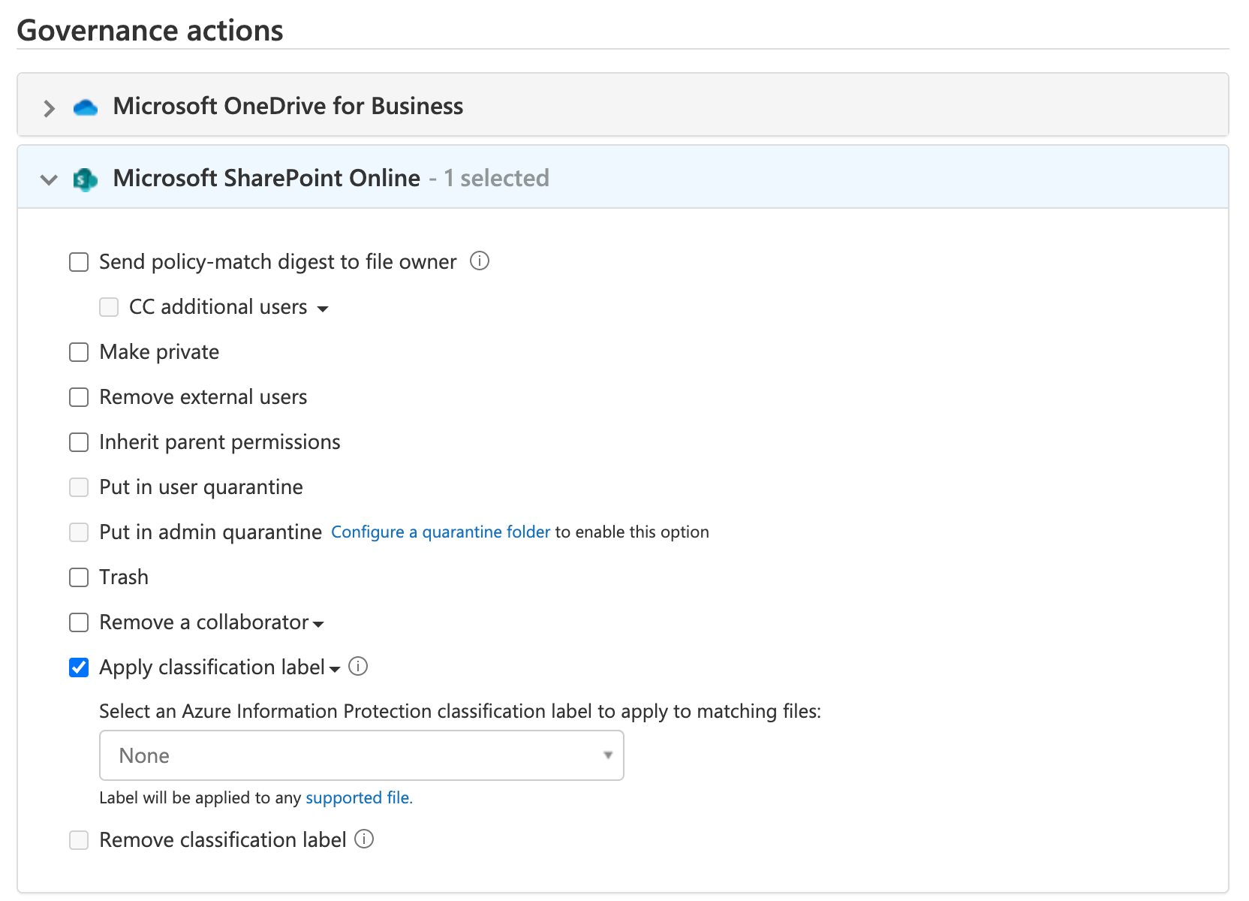
Cloud App Security

Slide 13
Windows Information Protection
Configured via Intune or Endpoint Manager
Designed to keep business and personal data separated on devices
WIP with enrollment and MDM policies
WIP without enrollment and MAM policies
Enlightened and Unenlightened Apps
Protects data within apps instead of managing the device itself
An example of WIP would be preventing a user from copying business data and pasting it into a personal application.

Slide 14
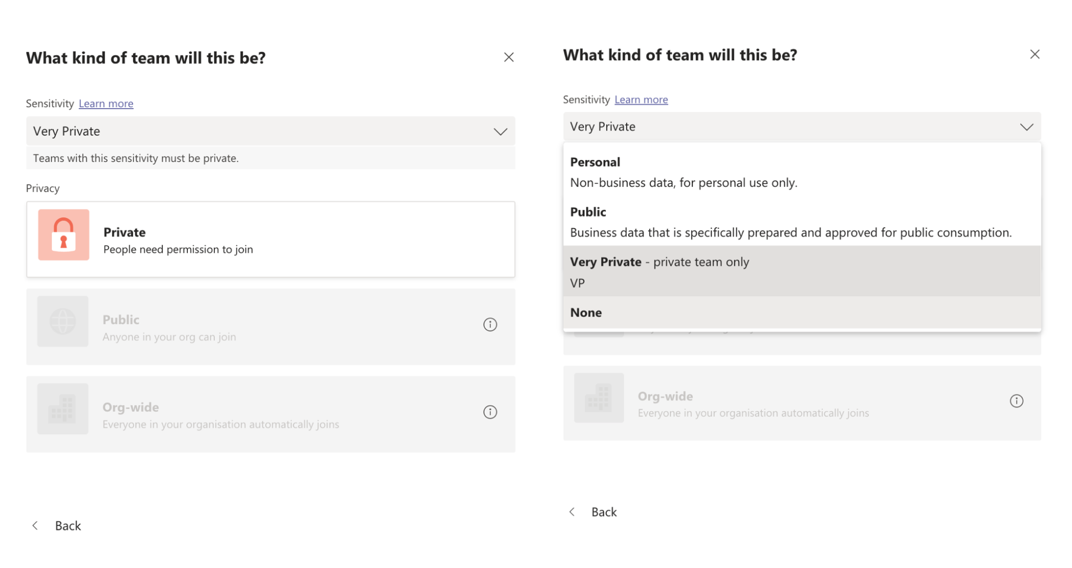
Recent advancements
Sensitivity labelling for Teams, Microsoft 365 Groups, and SharePoint

Slide 15
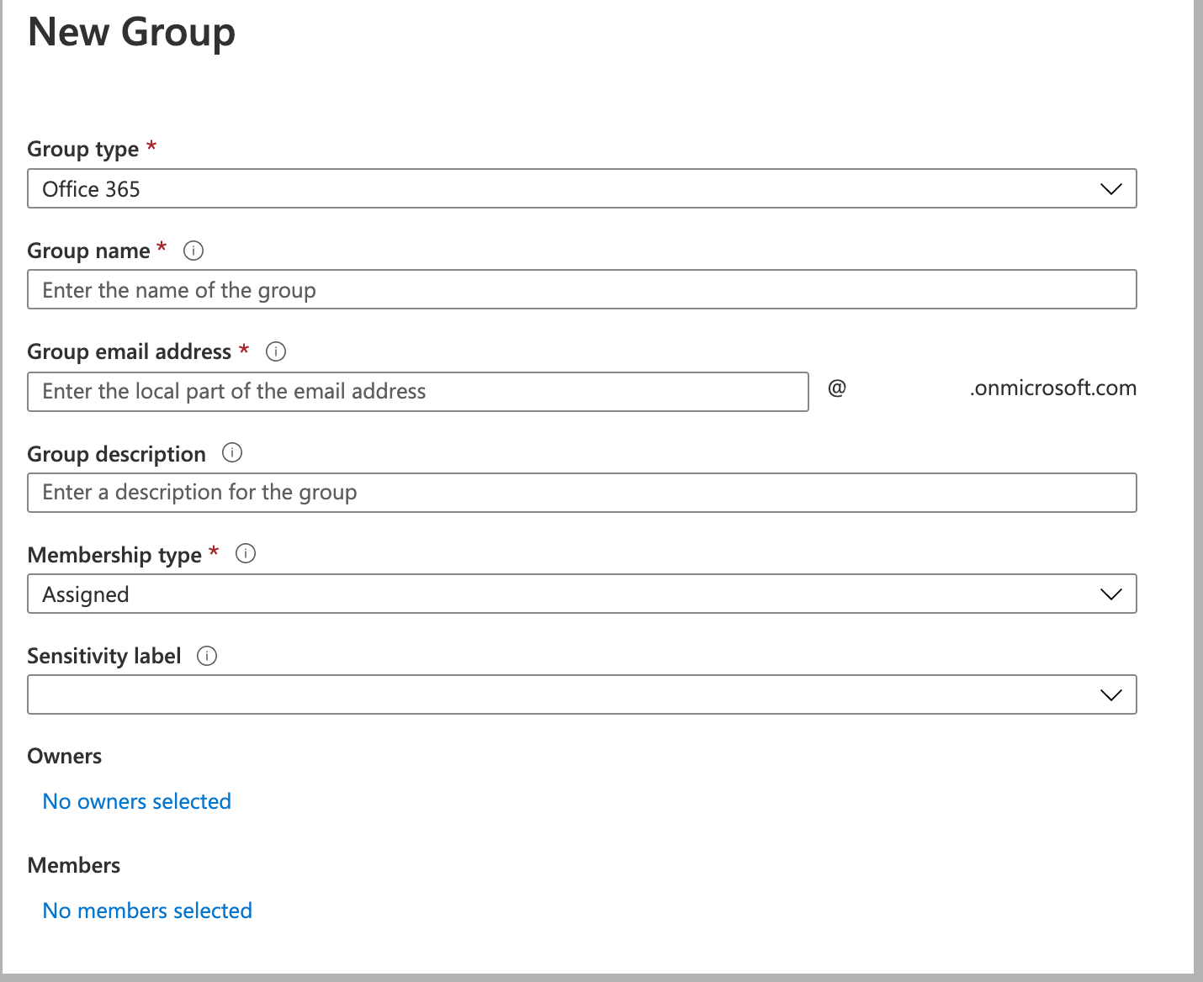
Recent advancements
Sensitivity labelling for Teams, Microsoft 365 Groups, and SharePoint

Slide 16
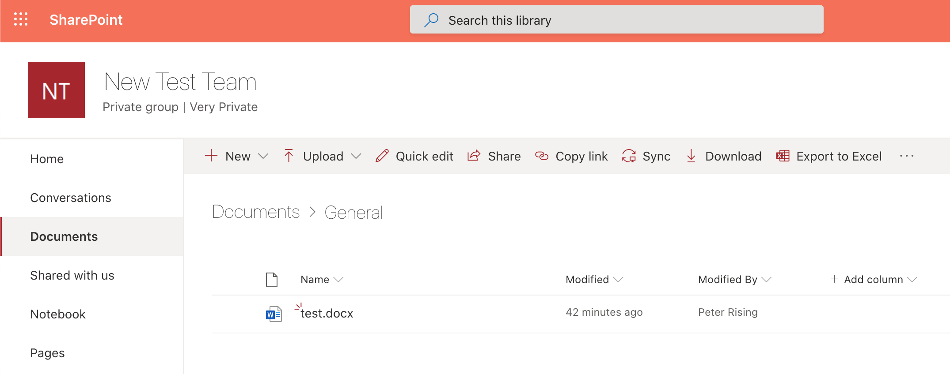
Recent advancements
Sensitivity labelling for Teams, Microsoft 365 Groups, and SharePoint

Slide 17
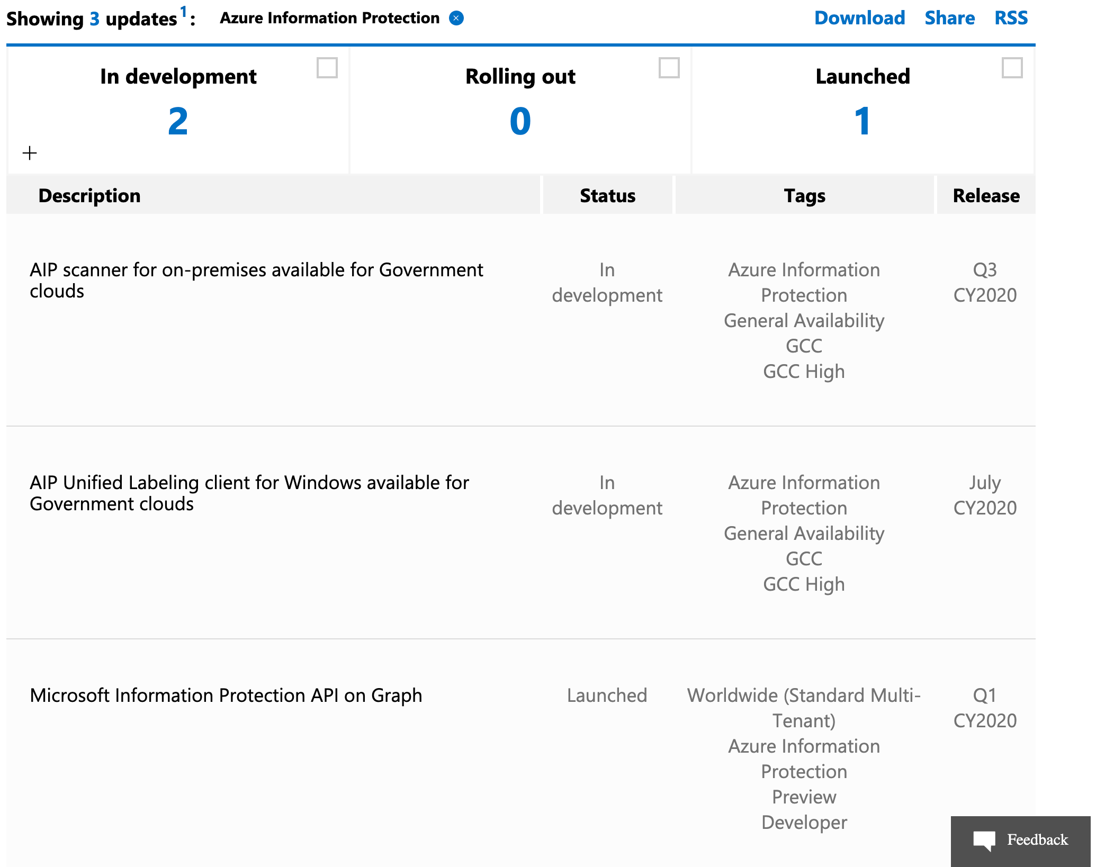
What’s to come?
Microsoft 365 roadmap
https://www.microsoft.com/en-us/microsoft-365/roadmap

Slide 18

Q&A

